Slide 1
What makes a goal?
Template from slidesgo
Inspection into the determinants of goal scoring in a soccer game season
Zimu Su

Slide 2
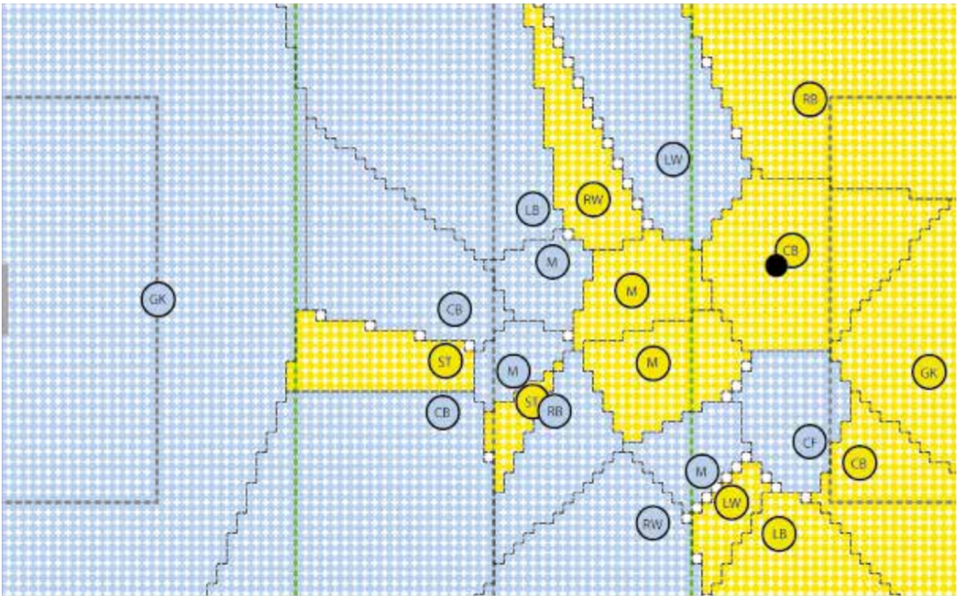
Revolution:
Graphic processing of the positional data in the soccer-WM 2006, Finale: Italy-France 6:4 . The first game with positional data available. (Jahrgang 2018)
Trend of data-driven analysis to evaluate game performance;
Metrics collection and computation based on advanced sensor technique;
Tactics decision based on comprehensive investigation in elite soccer.

Slide 3

What aspect of team performance significantly contributes to the goal scoring in a league season?

Slide 4
FEATURES
Shots per game
(shots on target + not on target)
Percentage of shot on target
Shots
Dribble success percentage
Pass percentage
Ball carrying & passing
Pressure success percentage
Tackle per game
Defensive actions

Slide 5






Source of Statistics
Time range: 2017 season – 2021 season
Total 590 rows of data

Slide 6
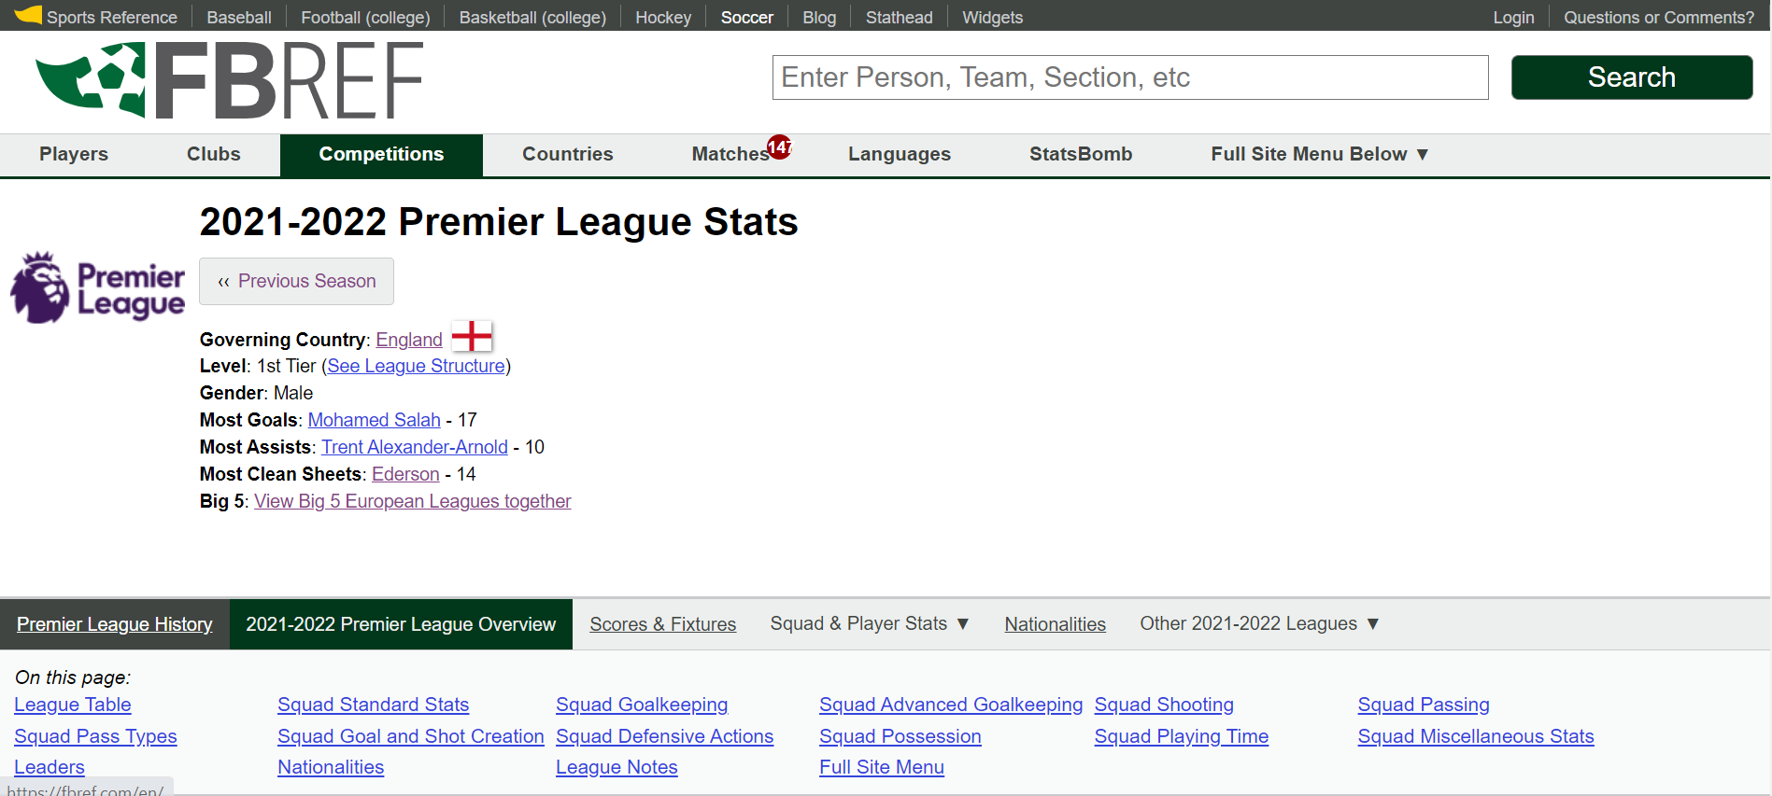
Web scraping from Fbref.com

Slide 7
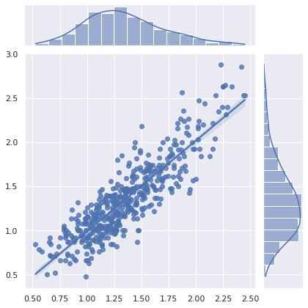
Model details
Data standardization
LASSO regularization
No multicollinearity
MAE: 0.165 goals per game
R2 score: 0.798
Adjust R2 score: 0.793
Actual Goal per game in season
Predicted goal per game in season

Slide 8
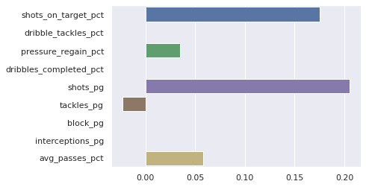
Coefficients analysis
Shots on target percentage and shots per game are most influential factors.
Success of pressure and passing balls also benefits goals per game.
Tackles is negatively related to goals.
Dribbles, blocks, interception, dribble tackles have no contributions to goals.

Slide 9
Conclusions & Suggestions
Shots matter, whatever they are on target or not.
Capabilities of passing ball and putting pressure are important.
Passing
Pressure

Slide 10
Dribbles have no contributions to score goals.
Defensive actions like blocks, interception, dribble tackles have no contributions to goals.
More tackles, less goals.
Tackles to force the opponents to stop the ball when approaching own penalty area.
More tackles indicates less ability to approach opponent penalty area to make the shots.

Slide 11
FUTURE WORK
Find significant factors to goal against (goals scored by opponents).
Make similar analysis at player level.

